Slide 1
Online Web Learning Portal:
Code_To_Develop

Slide 2

WHY TO LEARN ONLINE??
More Comfortable
Self paced
Learn from anywhere, anytime
Free or Less cost
Flexibility

Slide 3
OBJECTIVES
The main objectives of this project are:
To provide a user-friendly Online Web Learning Portal that covers all related topics (HTML, CSS and JavaScript) required for creating attractive, responsive, user-friendly and interactive websites.
Allows the user learn course sitting distance far away.

Slide 4
ABOUT
Features of this project are:
User friendly
Easy to use
Correct explanation of the topics
Optimized for mobile, tablets, desktops
Full fledged practice sessions
Real time editor

Slide 5
Tips from developers
Technical updates
Easy to read and understand
Overcomes time and space limitations
Distance learning

Slide 6
FUNCTIONAL DESCRIPTION
Main Page including all the options for the options of the page: Courses, Practice, Login, Updates, Editor, etc..
Courses section which includes:
(1)HTML Tutorial
(2)CSS Tutorial
(3)JavaScript Turorial
(4)Real time Editor

Slide 7
Practice section which includes:
(1)HTML AND CSS Practice
(2)JavaScript Practice
About Us section giving details of the developers.
Contact Us section for allowing user to leave any reply and connect from user through Facebook, Github, Gmail, Twitter.

Slide 8
Tips from Developers section containing tips from developers.
Updates section showing recent technical updates.
Sign Up Page
Login Page

Slide 9
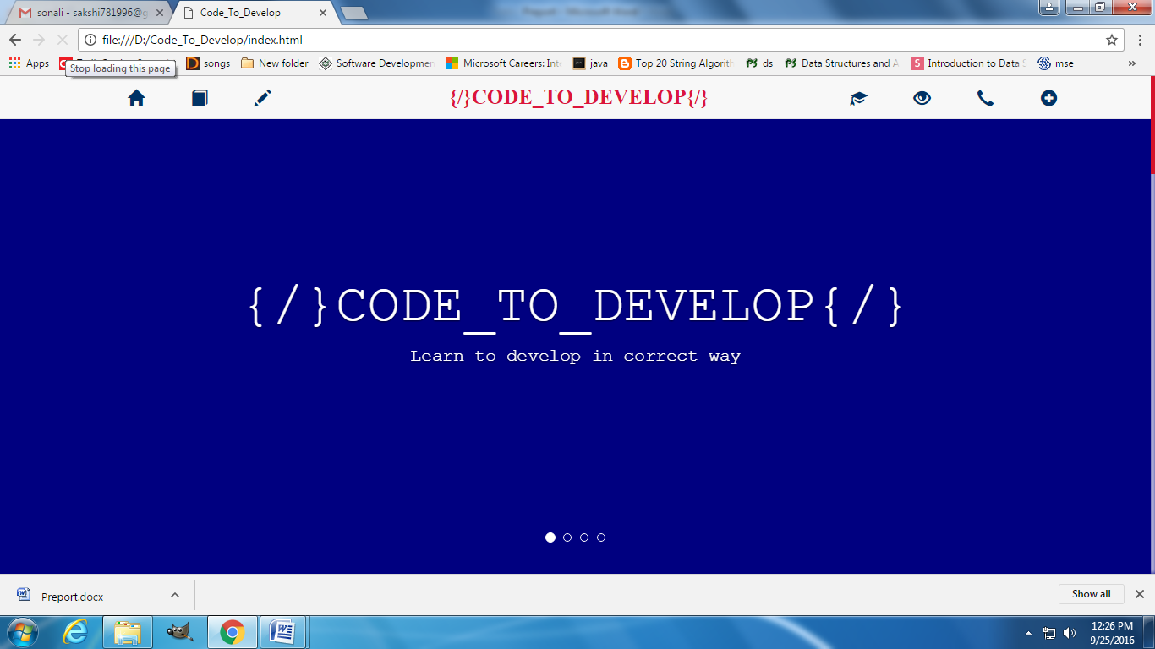
PROJECT INTERFACES

Slide 10
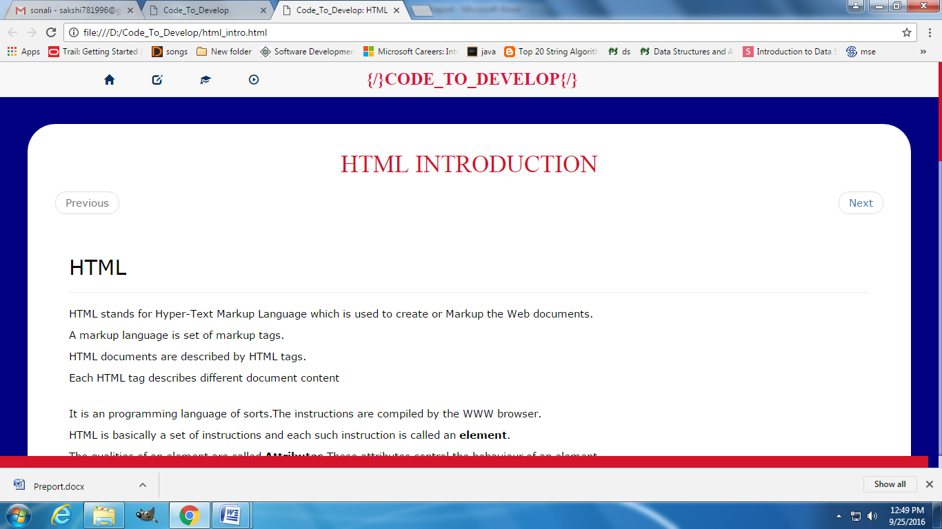

Slide 11
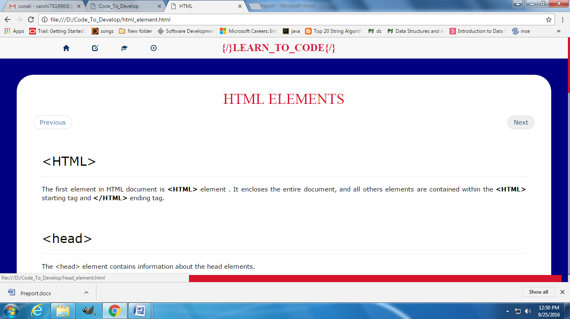

Slide 12
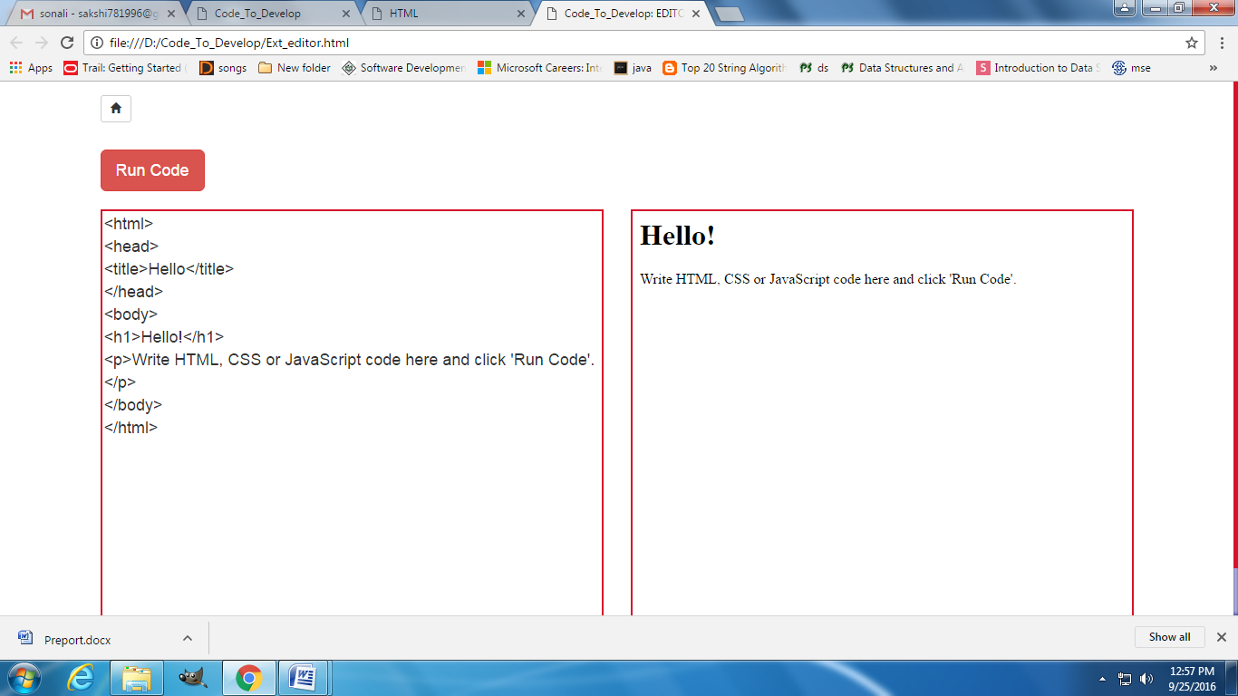

Slide 13
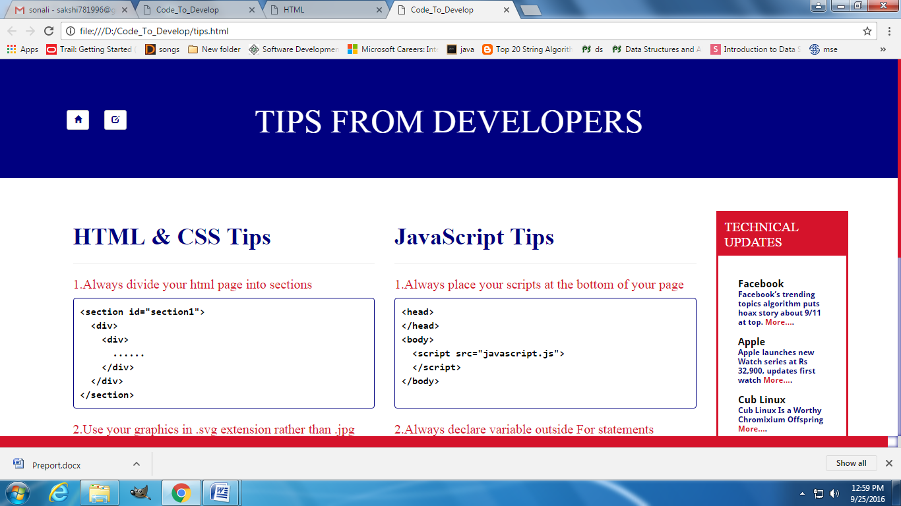

Slide 14
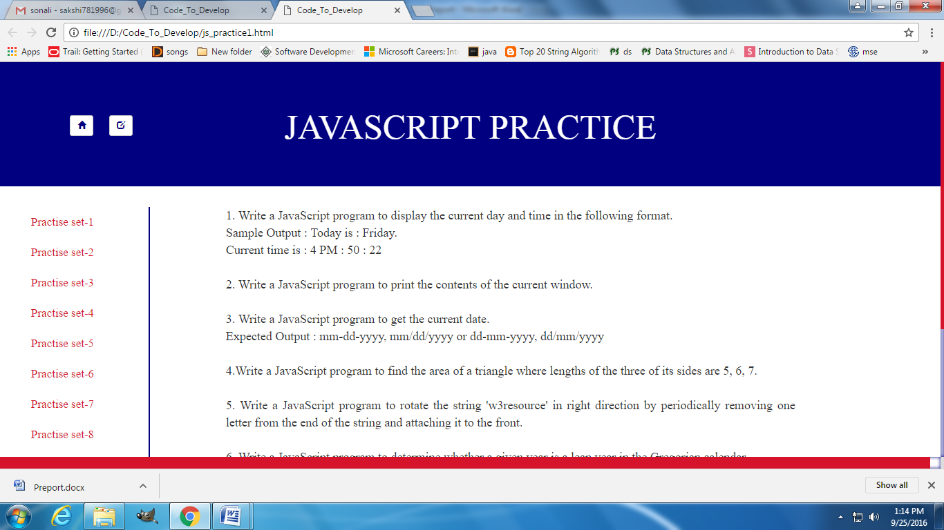

Slide 15
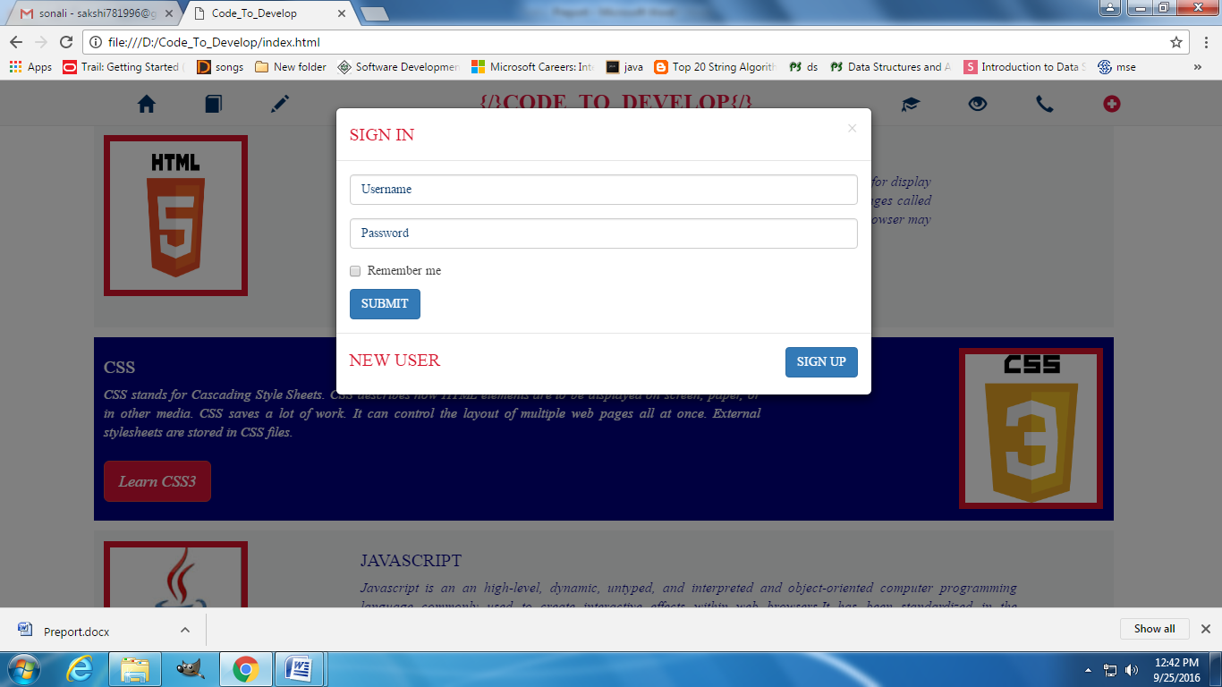

Slide 16
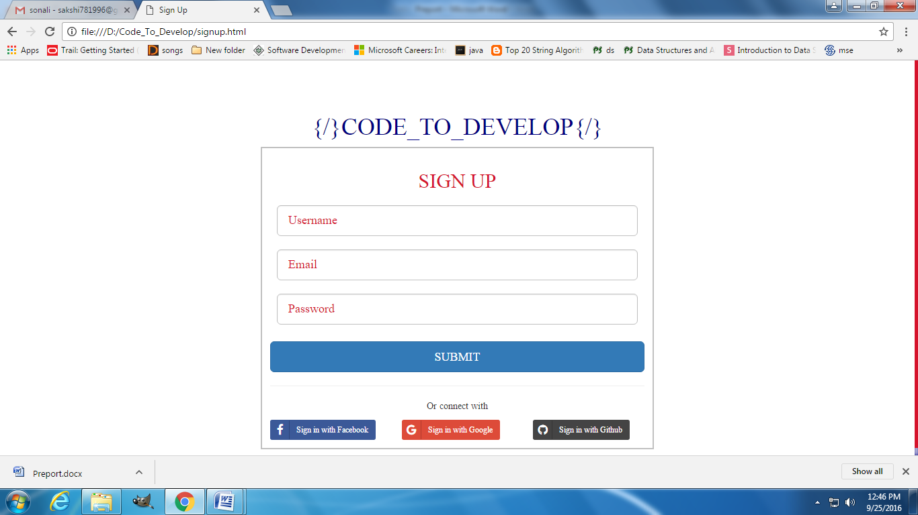

Slide 17
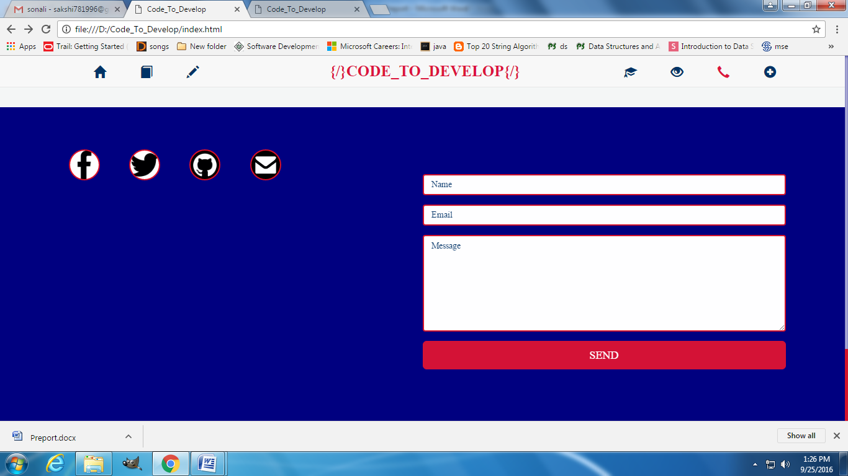

Slide 18
TECHNOLOGIES USED
HTML
CSS
JavaScript
Bootstrap

Slide 19
TOOLS USED
Sublime Text3
Chrome
Mozilla Firefox
Operating System: Windows

Slide 20
CONCLUSION
“Code_To_Develop” online web portal has been successfully implemented using the tools prevalent.
User will be pleased with the work done ij this website.

Slide 21
FUTURE WORK
Back-end Functionality
Accessibility to all
More content can be added
Editor can be enhanced
Feature of discussion forum to be added

Slide 22
Thank You

